Slide 1
Fundamentals of EMC
Building Blocks
John McCloskey
NASA/GSFC Chief EMC Engineer
Code 565
Building 23, room E203
301-286-5498
John.C.McCloskey@nasa.gov

Slide 2
Building Blocks
Permittivity and Permeability
Maxwell’s Equations
Electric Field, Potential, and Capacitance
Magnetic Field, Current, and Inductance
Capacitive (Electric Field) and Inductive (Magnetic Field) Coupling
Yin/Yang Relationship Between Currents and Radiated Fields
Wave Propagation
Why Do EMC Folks Speak in dB?
Differential Mode (DM) vs. Common Mode (CM)

Slide 3
Permittivity and Permeability
The electric and magnetic field properties of a material are determined by its permittivity and permeability, respectively:
Permittivity:
ε_{r} = relative permittivity, a.k.a. dielectric constant
ε₀ = permittivity of free space
(Farads per meter)
~ 8.84 pF/m
Permeability:
µ_{r} = relative permeability
µ₀ = permeability of free space
(Henries per meter)
~ 1.3 µH/m

Slide 4
Building Blocks
Permittivity and Permeability
Maxwell’s Equations
Electric Field, Potential, and Capacitance
Magnetic Field, Current, and Inductance
Capacitive (Electric Field) and Inductive (Magnetic Field) Coupling
Yin/Yang Relationship Between Currents and Radiated Fields
Wave Propagation
Why Do EMC Folks Speak in dB?
Differential Mode (DM) vs. Common Mode (CM)

Slide 5
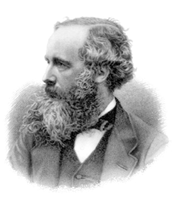
Maxwell’s Equations
James Clerk Maxwell (1831–1879)
Differential Forms
Integral Forms

Slide 6

Maxwell’s Equation #1: Gauss’s Law for Electric Field
Gauss’s Law for Electric Field:
Coulomb’s Law (the Force between charges):
E = electric field
Q = enclosed charge
ε = permittivity of medium
ds = elemental surface area of enclosing surface
  Integrated over surface area of a sphere of radius r:
  Charge produces an electric field
Q_{ext}
r
Q

Slide 7
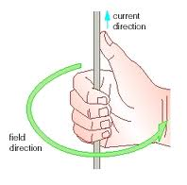
Maxwell’s Equation #2: Ampere’s Law
Ampere’s Law:
  Current produces a magnetic field
conduction current, I_{C}
(e.g. wire)
displacement current, I_{D}
(e.g. dielectric)
= magnetic field intensity (A/m)
I = I_{C} + I_{D}
Example:
For I = 1 A and r = 1/2π meter,
H = 1 A/m
r
Magnetic field vector direction follows “right hand rule”

Slide 8
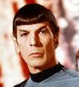
Maxwell’s Equation #3: Faraday’s Law
Faraday’s Law of Electromagnetic Induction
  Time varying magnetic flux produces an electromotive force (emf),
  a.k.a. potential
magnetic flux density (Webers/m² or Tesla)
+
-
V_{emf}
Life as we know it would not be possible without Faraday’s Law.

Slide 9
Maxwell’s Equation #4: Gauss’s Law for Magnetic Field
Gauss’s Law for Magnetic Field
  There is no isolated magnetic “charge”;
  No net magnetic flux through any closed surface;
  All magnetic field lines form closed loops
B
N
S

Slide 10

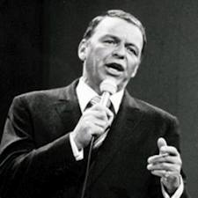
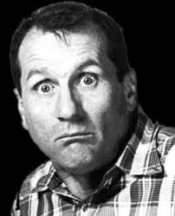
Fields Begetting Fields
Recall Ampere’s Law:
But in free space,
Thus in free space far from any sources,
Time-varying magnetic field begets electric field
Time-varying electric field begets magnetic field
H
E
H and E fields, H and E fields
Go together like cables and shields
This, I tell you, brother
You can’t have one without the other…

Slide 11
Building Blocks
Permittivity and Permeability
Maxwell’s Equations
Electric Field, Potential, and Capacitance
Magnetic Field, Current, and Inductance
Capacitive (Electric Field) and Inductive (Magnetic Field) Coupling
Yin/Yang Relationship Between Currents and Radiated Fields
Wave Propagation
Why Do EMC Folks Speak in dB?
Differential Mode (DM) vs. Common Mode (CM)

Slide 12
What Is This Thing Called Electric Field?
Electric field is negative gradient of potential
Where there is ΔV, there is electric field
+Q
+
Electric field between conductors
V
E
-
-Q
(V/m)

Slide 13
What Is This Thing Called Capacitance?
Capacitance is the ratio of charge to potential between 2 conductors
Intentional or unintentional
+Q
+
V
-
-Q
For parallel plate:
PROPORTIONAL TO SURFACE AREA
INVERSELY PROPORTIONAL TO SEPARATION
ε₀ = permittivity of free space = ~8.84 pF/m

Slide 14
Capacitive Reactance (Impedance)
+Q
+
Electric field induces displacement current through dielectric’s impedance
Z_{C}
V
E
-
I
-Q
CAPACITIVE REACTANCE (IMPEDANCE) DECREASES WITH FREQUENCY

Slide 15
Building Blocks
Permittivity and Permeability
Maxwell’s Equations
Electric Field, Potential, and Capacitance
Magnetic Field, Current, and Inductance
Capacitive (Electric Field) and Inductive (Magnetic Field) Coupling
Yin/Yang Relationship Between Currents and Radiated Fields
Wave Propagation
Why Do EMC Folks Speak in dB?
Differential Mode (DM) vs. Common Mode (CM)

Slide 16
What Is This Thing Called Magnetic Field?
v
F
q
+
B

Slide 17
What Is This Thing Called Inductance?
Inductance is the ratio of induced magnetic flux to the current causing it
PROPORTIONAL TO LOOP AREA
CULPRIT CIRCUIT
I_{C}
assuming constant B over area
VICTIM CIRCUIT
V_{emf}
PROPORTIONAL TO LOOP AREA

Slide 18
Self Inductance and Mutual Inductance
Magnetic flux may be induced either by:
  Same circuit (self-inductance)
  Different circuit (mutual inductance)
Self inductance
Mutual inductance
I
I
A = area of loop
A = area of loop

Slide 19
Inductive Reactance (Impedance)
CULPRIT CIRCUIT
I_{C}
VICTIM CIRCUIT
V_{emf}
INDUCTIVE REACTANCE (IMPEDANCE) INCREASES WITH FREQUENCY

Slide 20

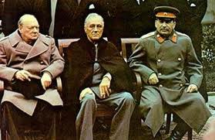
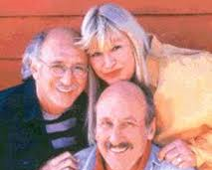



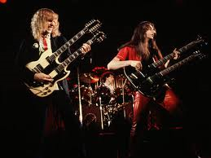
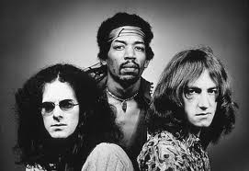
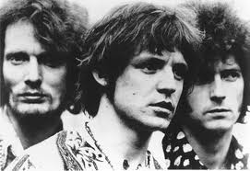

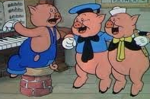
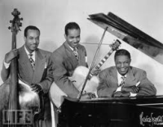

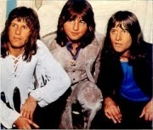


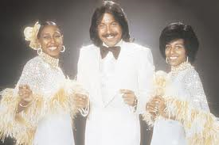
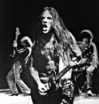

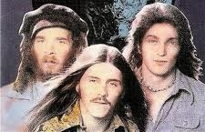


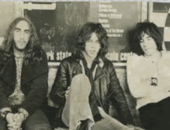
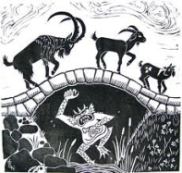


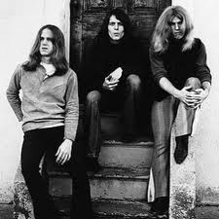
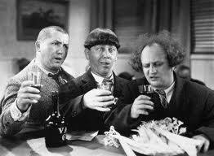
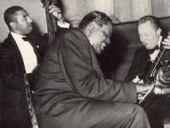
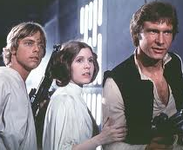

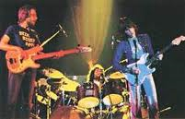




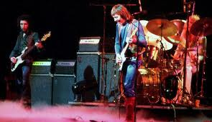
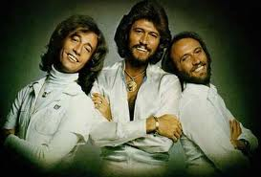
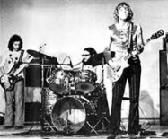
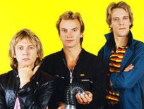
Power Trios
Power Trio #1: Electric field, potential, capacitance
Power Trio #2: Magnetic field, current, inductance
Need both trios to transmit power

Slide 21
Building Blocks
Permittivity and Permeability
Maxwell’s Equations
Electric Field, Potential, and Capacitance
Magnetic Field, Current, and Inductance
Capacitive (Electric Field) and Inductive (Magnetic Field) Coupling
Yin/Yang Relationship Between Currents and Radiated Fields
Wave Propagation
Why Do EMC Folks Speak in dB?
Differential Mode (DM) vs. Common Mode (CM)

Slide 22
Electric Field (Capacitive) Coupling
AC POTENTIAL IN CULPRIT CIRCUIT …
I_{CV}
V_{C}
CULPRIT CIRCUIT
R₂
C_{CV}
+
V_{V}
-
R₁
VICTIM CIRCUIT
…INDUCES AC POTENTIAL IN VICTIM CIRCUIT ACCORDING TO IMPEDANCE DIVIDER
As (R₁ || R₂ ) → ∞, V_{V} / V_{C} → 1

Slide 23
Electric Field (Capacitive) Coupling
I_{CV} = jωC_{CV}V_{C}
V_{C}
CULPRIT CIRCUIT
R₂
+
V_{V}
-
R₁
VICTIM CIRCUIT
For jωC_{CV}(R₁ || R₂ ) << 1 (i.e. low frequencies):

Slide 24
Magnetic Field (Inductive) Coupling
CURRENT IN CULPRIT CIRCUIT PRODUCES MAGNETIC FIELD (AMPÈRE’S LAW)
CULPRIT CIRCUIT
I_{C}
VICTIM CIRCUIT
V_{emf}
MAGNETIC FIELD PRODUCES NOISE VOLTAGE IN VICTIM CIRCUIT
(FARADAY’S LAW)

Slide 25
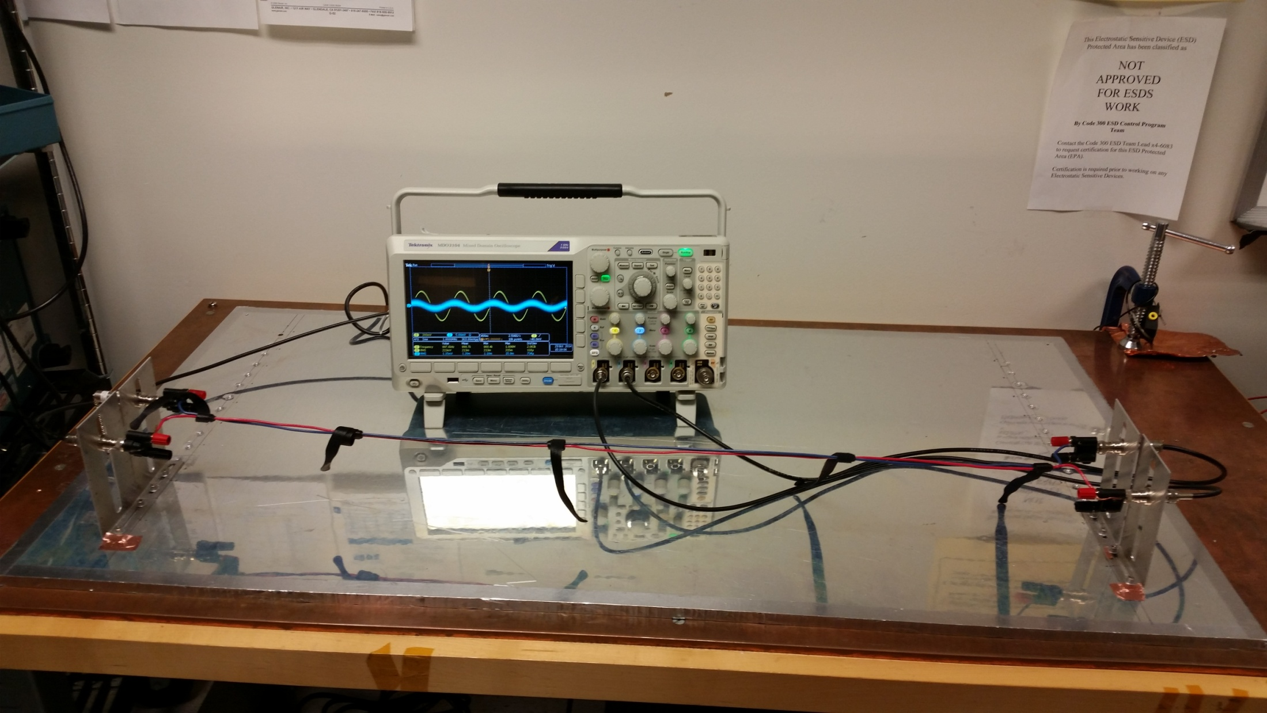
Demo 1: Capacitive and Inductive Coupling

Slide 26
Demo 1: Capacitive and Inductive Coupling (cont.)
Equipment
  Tektronix MDO3104 oscilloscope (built-in signal generator)
  Test fixture w/ 2 single wires, 4 banana-BNC adaptors
  Velcro straps
  3 coax cables
    Signal generator output to culprit wire input
    Culprit wire output to scope channel 1
    Victim wire output to scope channel 2
  50 Ω termination on victim wire “input”
Setup
  Scope channel 2: 50 Ω throughout
  Scope channel 1: 1 MΩ for capacitive coupling, 50 Ω for inductive
  AFG
    Sine, 5 Vp-p, 100 kHz, then 1 MHz
    Square, 5 Vp-p, 1 MHz

Slide 27
Demo 1: Capacitive and Inductive Coupling (cont.)
CAPACITIVE COUPLING
I_{V} = ~0
R_{L} = 1 MΩ
I_{CV}
CULPRIT CIRCUIT
R_{FE}
C_{CV}
R_{S} = 50 Ω
R_{NE}
VICTIM CIRCUIT
V_{S} = 5 V p-p
= ~1.8 Vrms
R_{NE} = R_{FE} = 50 Ω
@ 100 kHz: X_{C} = ~16 kΩ, V_{V} = ~3 mVrms
@ 1 MHz: X_{C} = ~1.6 kΩ, V_{V} = ~30 mVrms

Slide 28
Demo 1: Capacitive and Inductive Coupling (cont.)
INDUCTIVE COUPLING
I_{V} = V_{S} / (100 Ω) = 18 mArms
R_{L} = 50 Ω
CULPRIT CIRCUIT
R_{FE}
R_{S} = 50 Ω
R_{NE}
VICTIM CIRCUIT
V_{S} = 5 V p-p
V_{emf}
= ~1.8 Vrms
R_{NE} = R_{FE} = 50 Ω
@ 100 kHz: X_{L} = ~0.6 Ω, V_{emf} = ~10 mVrms
@ 1 MHz: X_{C} = ~6 Ω, V_{emf} = ~100 mVrms

Slide 29
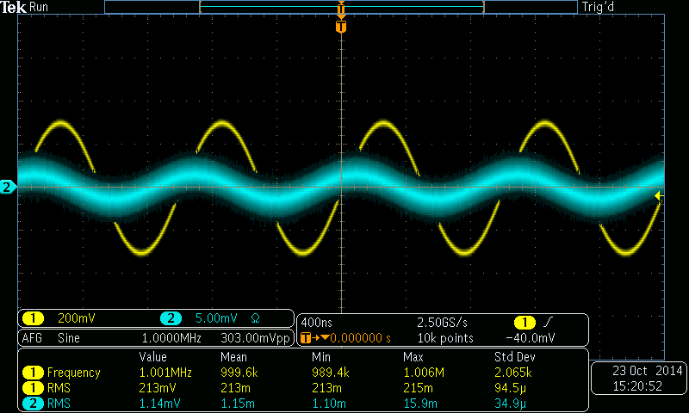
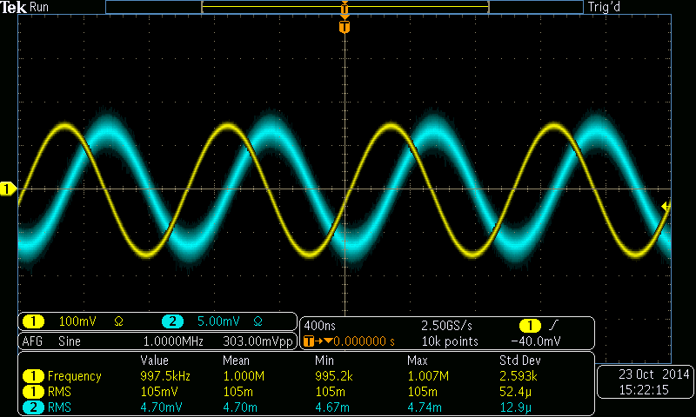
Demo 1: Capacitive and Inductive Coupling (cont.)
CAPACITIVE
INDUCTIVE

Slide 30
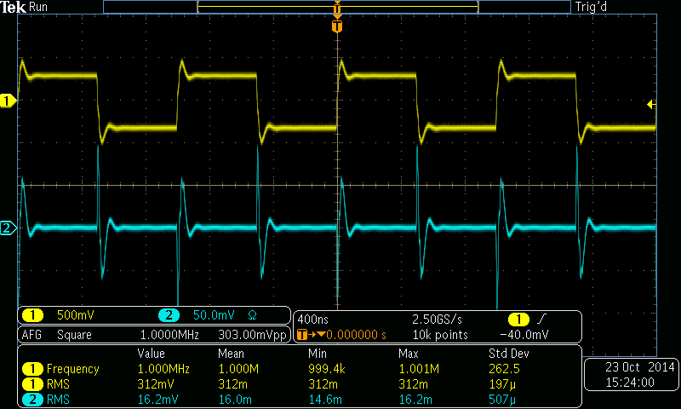
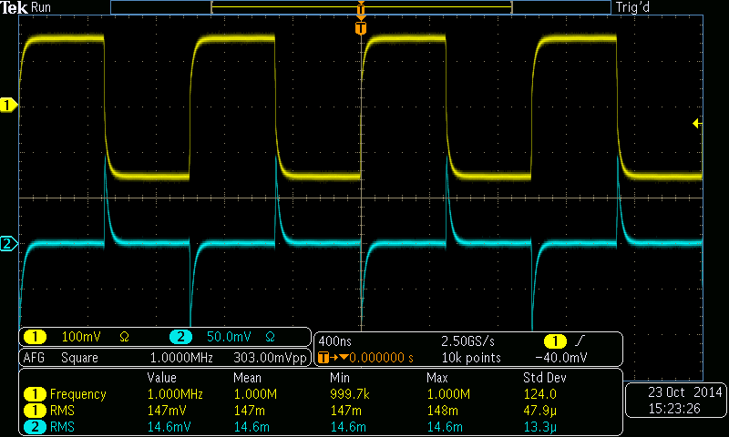
Demo 1: Capacitive and Inductive Coupling (cont.)
CAPACITIVE
INDUCTIVE

Slide 31

Building Blocks
Permittivity and Permeability
Maxwell’s Equations
Electric Field, Potential, and Capacitance
Magnetic Field, Current, and Inductance
Capacitive (Electric Field) and Inductive (Magnetic Field) Coupling
Yin/Yang Relationship Between Currents and Radiated Fields
Wave Propagation
Why Do EMC Folks Speak in dB?
Differential Mode (DM) vs. Common Mode (CM)

Slide 32
Yin/Yang Relationship Between Current and Radiated Fields
Electric (Hertzian) Dipole
z
θ
r
Complex dependence on 1/r and 1/r² in near field
Complex dependence on 1/r, 1/r², & 1/r³ in near field
dl
y
x
Wavenumber:
Only 1/r dependence remains in far field
Only 1/r dependence remains in far field
z
Magnetic (Loop) Dipole
θ
r
Complex dependence on 1/r, 1/r², & 1/r³ in near field
I
Complex dependence on 1/r and 1/r² in near field
b
y
x
Only 1/r dependence remains in far field
Only 1/r dependence remains in far field
Magnetic dipole moment:

Slide 33
Yin/Yang Relationship Between Current and Radiated Fields (cont.)
Radiated fields originate from currents in culprit circuits
Reciprocity: Incident radiated fields induce currents in victim circuits
Controlling flow of current is crucial for controlling electromagnetic interference (EMI)
DO YOU KNOW WHERE YOUR CURRENTS ARE FLOWING?

Slide 34
Building Blocks
Permittivity and Permeability
Maxwell’s Equations
Electric Field, Potential, and Capacitance
Magnetic Field, Current, and Inductance
Capacitive (Electric Field) and Inductive (Magnetic Field) Coupling
Yin/Yang Relationship Between Currents and Radiated Fields
Wave Propagation
Why Do EMC Folks Speak in dB?
Differential Mode (DM) vs. Common Mode (CM)

Slide 35
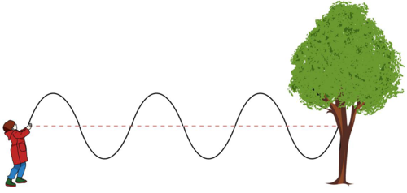
Demo 2: Wave Propagation

Slide 36
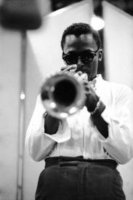
Wave Equations
In a simple (linear, isotropic, & homogeneous) non-conducting medium far from any sources of charge or current, Maxwell’s equations reduce to the following pair of wave equations:
Solutions of the form (one dimension):
Wavenumber:
So what?

Slide 37
Wave Equations – General Solution
Direction of propagation
E
3λ/4
λ/4
λ/2
λ
z
t = 0
t = π/ω
ωt – kz = constant
t = π/2ω
Velocity of propagation:
Wavelength:

Slide 38

Velocity of Propagation
The wave equations state that the electric and magnetic fields propagate through a medium as a wave with a velocity determined by the medium’s permittivity and permeability:
In free space, the velocity of propagation is equal to the speed of light (µ_{r} = ε_{r} = 1):
= 0.3 m/ns = approx. 1 foot/ns
I like to move it, move it…

Slide 39
Impedance
Wave impedance
Intrinsic (characteristic) impedance of medium:
Characteristic impedance of free space:
V/m
= Ω
A/m

Slide 40
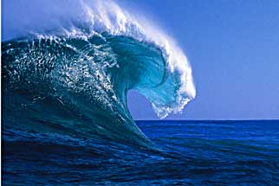
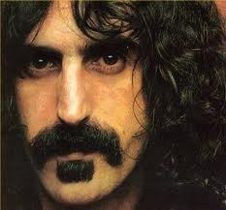
Wave Propagation (a practical look)
Finite speed of light gives rise to electromagnetic waves propagating in space
H
H
Poynting Vector
E
E
Direction of propagation
Power density in W/m²
(V/m x A/m)
f (MHz) | λ (m)
3 | 100
30 | 10
300 | 1
3000 | 0.1
Wavelength
(λ)
T = 1/f
f(t)
The crux of the biscuit…

Slide 41
Building Blocks
Permittivity and Permeability
Maxwell’s Equations
Electric Field, Potential, and Capacitance
Magnetic Field, Current, and Inductance
Capacitive (Electric Field) and Inductive (Magnetic Field) Coupling
Yin/Yang Relationship Between Currents and Radiated Fields
Wave Propagation
Why Do EMC Folks Speak in dB?
Differential Mode (DM) vs. Common Mode (CM)

Slide 42
Why Do EMC Folks Speak in dB?
It’s all about dynamic range; measurements can span many orders of magnitude
dB always expresses a power ratio:
Because power is proportional to the square of voltage or current, when used as a ratio of voltages or currents, the conversions are as follows:
Typical references used in EMI testing are 1 µV , 1 µA, and 1 mW:
0 dBµV = 1 µV, 60 dBµV = 1 mV, 120 dBµV = 1 V
0 dBµA = 1 µA, 60 dBµA = 1 mA, 120 dBµA = 1 A
0 dBm = 1 mW, 30 dBm = 1 W, 60 dBm = 1 kW

Slide 43
Some Handy dB Conversions

Slide 44
Some Handy dB Conversions (cont.)
A
A
A α f
= -20 dB/decade
= 20 dB/decade
A α 1/f
f
f

Slide 45
dBm to dBμV Conversion for 50 Ω System
For 50 Ω system:
0 dBm = 1 mW = 107 dBμV = 224 mVrms
For 50 Ω system only!!!

Slide 46
dBμV to dBμA Conversion for 50 Ω System
For 50 Ω system:
For 50 Ω system only!!!

Slide 47
Building Blocks
Permittivity and Permeability
Maxwell’s Equations
Electric Field, Potential, and Capacitance
Magnetic Field, Current, and Inductance
Capacitive (Electric Field) and Inductive (Magnetic Field) Coupling
Yin/Yang Relationship Between Currents and Radiated Fields
Wave Propagation
Why Do EMC Folks Speak in dB?
Differential Mode (DM) vs. Common Mode (CM)

Slide 48
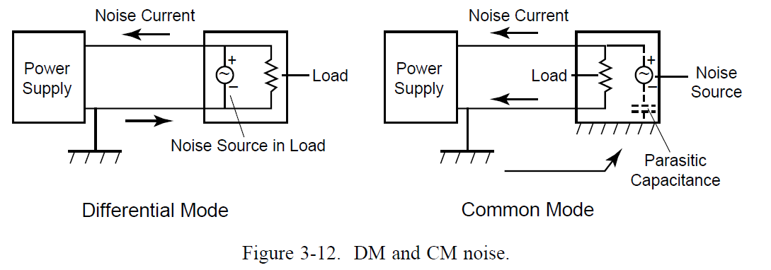
Differential Mode (DM) vs. Common Mode (CM)
Figure below from Marshall Space Flight Center Electromagnetic Compatibility Design and Interference Control (MEDIC) Handbook, p. 35
Knowledge of whether noise currents are DM or CM are essential to diagnose and fix problems
I_{DM}
I_{CM}
Uncontrolled CM currents are a common cause of EMI problems

Slide 49
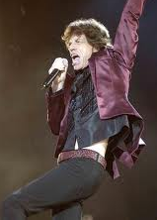
Is It Really Common Mode?
Is a line-to-chassis measurement a common mode measurement?
  LVDS Example
V₊
EUT
V₋
1.2 V typ.
0 V
SCOPE
I know…
It’s only common mode
But I don’t like it…

Slide 50
Is It Really Common Mode (cont.)?
Answer: NO.
LINE-TO-GROUND
V₊
V₋
0 V
0 V
COMMON MODE
EUT
1.2 V typ.
0 V
SCOPE
DIFFERENTIAL MODE
0 V
LINE-TO-GROUND MEASUREMENT COMBINES COMMON MODE AND DIFFERENTIAL MODE INFORMATION.
IT IS NOT A COMMON MODE MEASUREMENT.

Slide 51
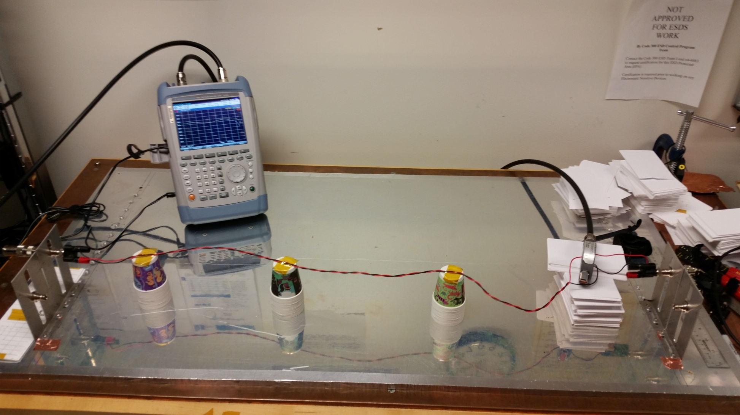
Demo 3: DM vs. CM Currents

Slide 52
Demo 3: DM vs. CM Currents (cont.)
Equipment
  R&S FSH4 spectrum/network analyzer
  2 large coax cables with N-connectors
  2 N-BNC adaptors
  Fixture w/twisted pair, 2 banana-BNC adaptors
  RG-48 coax, 2 BNC-banana adaptors, 2 banana-BNC adaptors
  2 BNC-banana adaptors (for coax)
Setup
  FSH4 in network analyzer mode
  Sweep from 100 kHz – 300 MHz

Slide 53
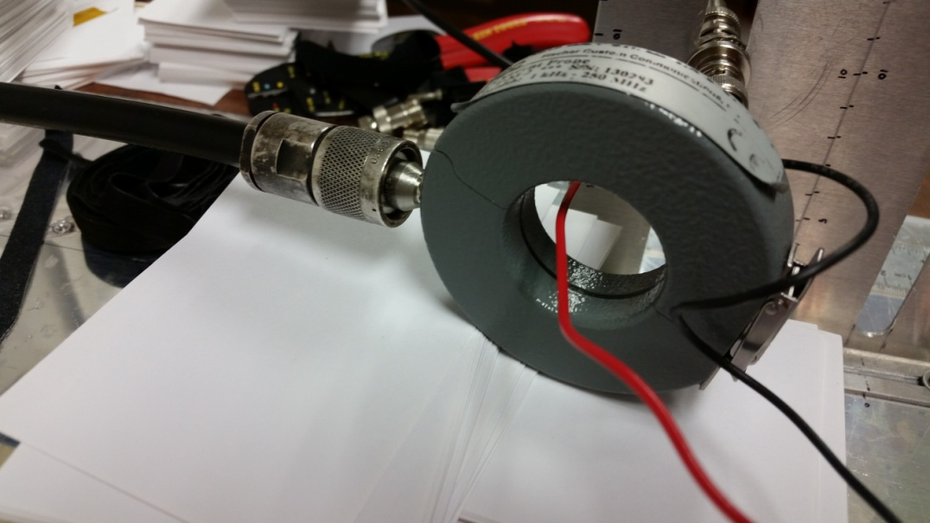
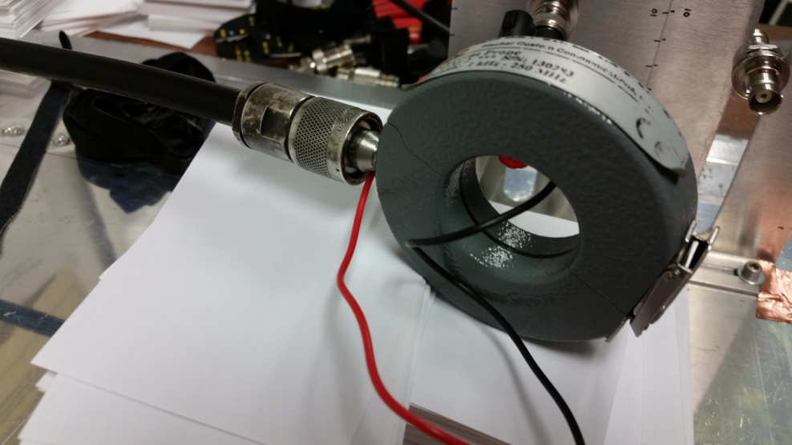
Demo 3: DM vs. CM Currents (cont.)
SINGLE WIRE MEASUREMENTS
(+) wire only
(-) wire only

Slide 54
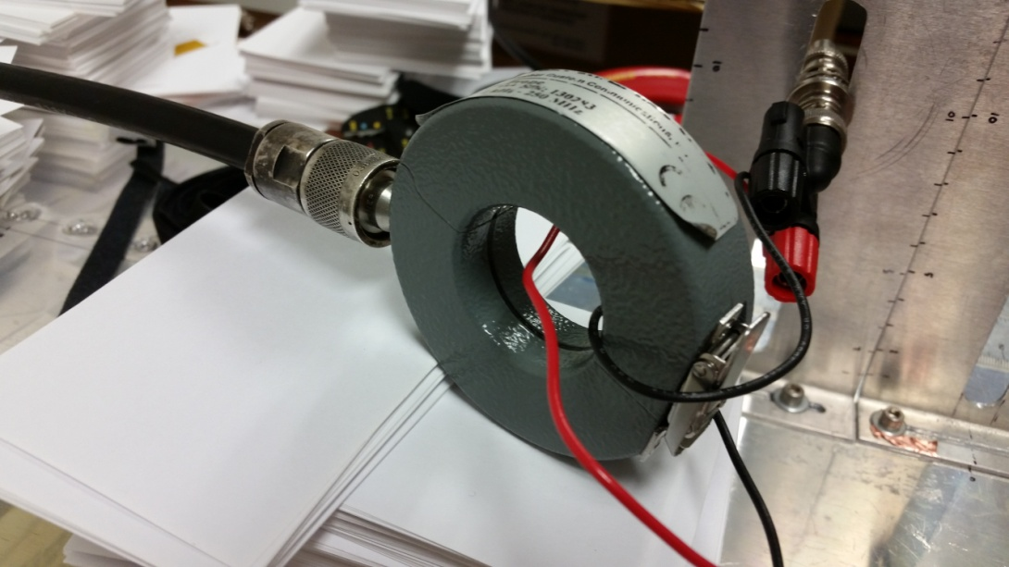
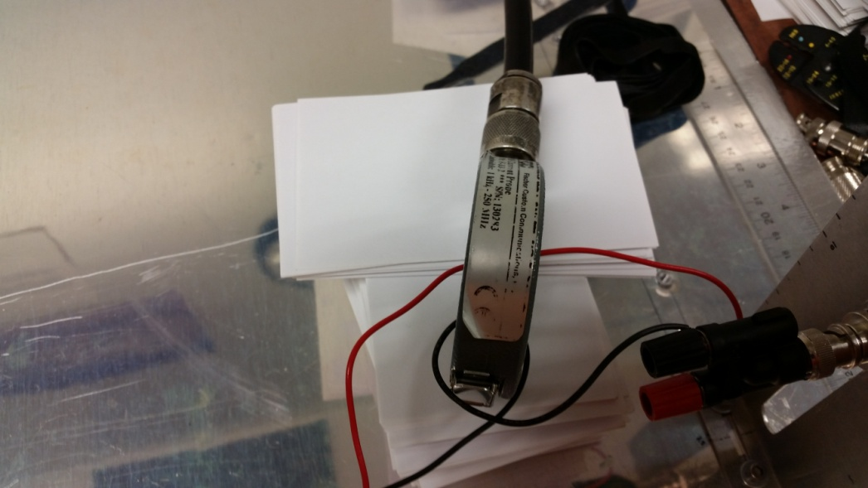
Demo 3: DM vs. CM Currents (cont.)
DIFFERENTIAL MODE (DM)
NOTE: This method measures 2x (6 dB higher) than the true DM current.

Slide 55
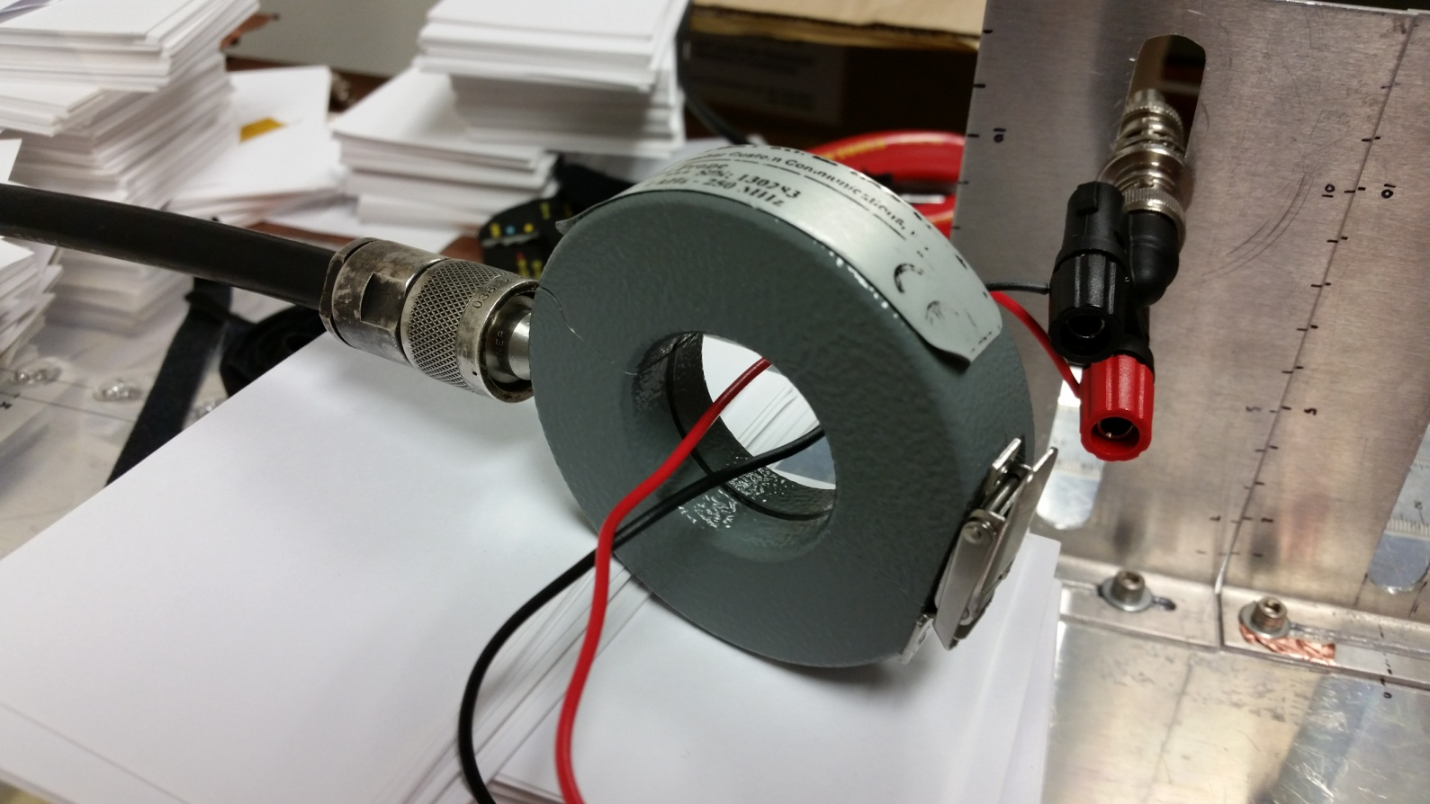
Demo 3: DM vs. CM Currents (cont.)
COMMON MODE (CM)

Slide 56
Demo 3: DM vs. CM Currents (cont.)

Slide 57
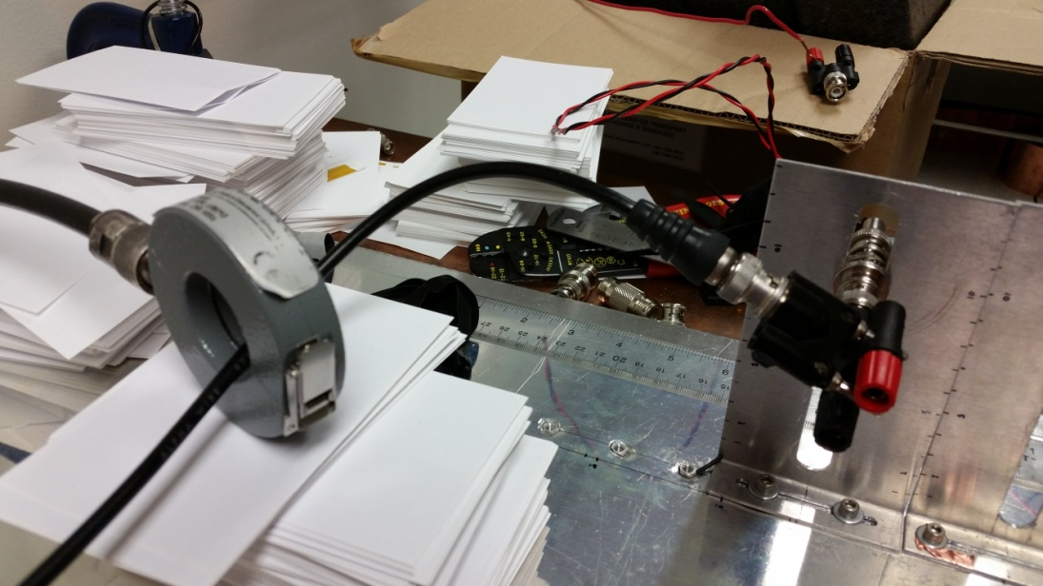
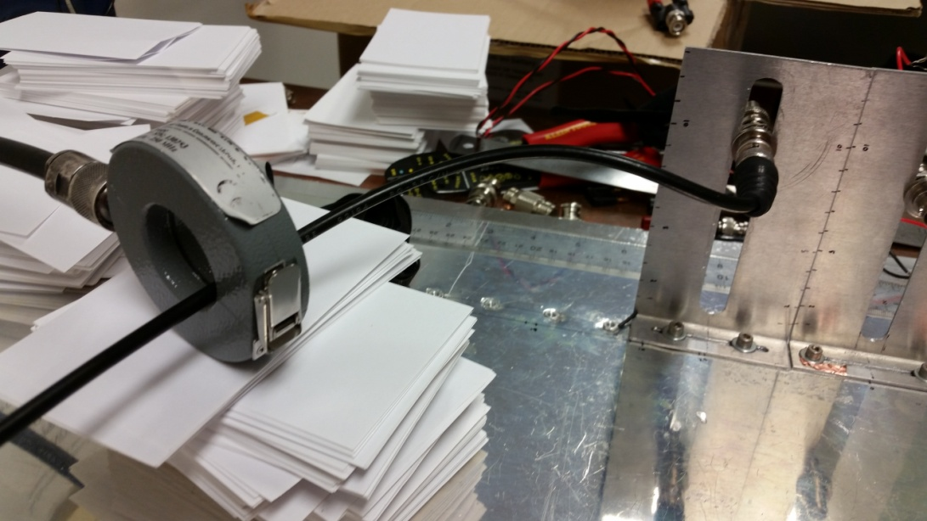
Demo 3: DM vs. CM Currents (cont.)
CM - COAX
OPEN SHIELD
TERMINATED SHIELD

Slide 58
Demo 3: DM vs. CM Currents (cont.)

Slide 59
If You Remember Nothing Else From Today…
DO YOU KNOW WHERE YOUR CURRENTS ARE FLOWING?

